Slide 1
Getting started with SharePoint Framework
Setup development environments

Slide 2
Agenda
Setting up your computer
Q&A

Slide 3
Setting up your computer

Slide 4
Setting Up Your Computer Steps
Install developer tools
Install Yeoman and gulp
Install Yeoman SharePoint generator
Install optional tools

Slide 5
Install developer tools – NodeJS and npm
Install NodeJS Long Term Support (LTS) version.
If you are using a Mac, it is recommended you use homebrew to install and manage NodeJS.
make sure you are running V3 of npm
npm install -g npm@3
Linux
sudo npm install -g npm@3

Slide 6




Install developer tools – Code Editors
Visual Studio Code
Sublime
Atom
Webstorm
Not all these tools are required. Just install he ones you want to use.

Slide 7
Install developer tools – Windows Build Tools
PC
npm install -g --production windows-build-tools
Ubuntu
sudo apt-get install build-essential
fedora
sudo yum install make automake gcc gcc-c++ kernel-devel
Notes:
You need to install windows-build-tools. windows-build-tools will install Visual C++ Build Tools 2015, provided free of charge by Microsoft. These tools are required to compile popular native modules. It will also install Python 2.7, configuring your computer and npm appropriately.

Slide 8
Install developer tools – Visual Studio
If you want to use Visual Studio as your development environment, install the following required tools and updates:
Visual Studio 2015
Visual Studio Update 3 or later
Node.js Tools for Visual Studio
Note. Developer experience in Visual Studio 2015 is not really optimal

Slide 9

Install Yeoman and gulp
Yeoman helps you kick-start new projects
SharePoint client-side development tools include a Yeoman generator for creating new web parts.
npm install -g yo gulp
Notes:
Yeoman helps you kick-start new projects, and prescribes best practices and tools to help you stay productive. SharePoint client-side development tools include a Yeoman generator for creating new web parts. The generator provides common build tools, common boilerplate code, and a common playground web site to host web parts for testing.
Enter the following command to install Yeoman and gulp:
npm i -g yo gulp

Slide 10
Install Yeoman SharePoint generator
The Yeoman SharePoint web part generator helps you quickly create a SharePoint client-side solution project with the right toolchain and project structure.
npm install -g @microsoft/generator-sharepoint
Notes:
The Yeoman SharePoint web part generator helps you quickly create a SharePoint client-side solution project with the right toolchain and project structure.
Enter the following command to install the Yeoman SharePoint generator:
npm i -g @microsoft/generator-sharepoint

Slide 11
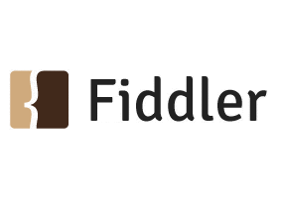

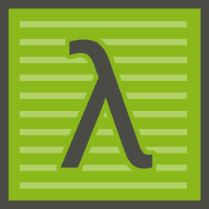
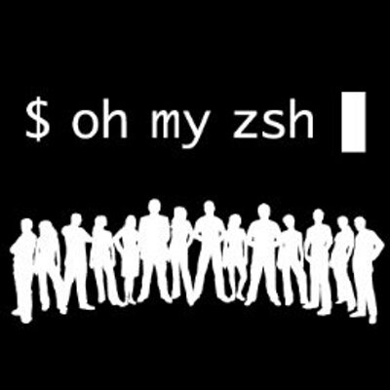

Install optional tools
Fiddler
Postman plugin for Chrome
Cmder for Windows
Oh My Zsh for Mac
Git source control tools
Notes:
Here are some tools that might come in handy as well:
Fiddler
Postman plugin for Chrome
Cmder for Windows
Oh My Zsh for Mac
Git source control tools

Slide 12
DEMO
Installing needed tools and libraries to your development environment

Slide 13
Summary
Setting up your computer
Q&A

Slide 14
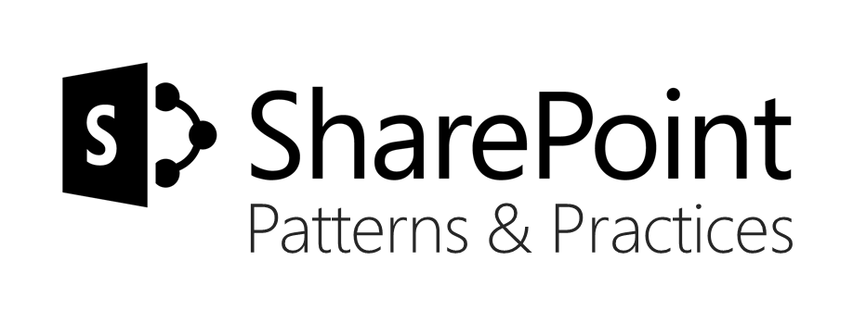
Sharing is caring…
Code samples and solutions
Reusable components
Guidance documentation
Monthly community calls
SharePoint Framework
SharePoint add-ins
Microsoft Graph
Office 365 APIs
http://aka.ms/SharePointPnP

Slide 15

Q&A

Slide 16


